Slide 2
Factors That Lead to Attrition Presentation
By Muchigi Kimari

Slide 3
Discussion Points
Our Data Source
Hypothesis
EDA on factors I think lead to attrition EDA
Attrition Prediction Model
Monthly Income Prediction Model
My factors vs model selection factors
Attrition prediction for my work environment
Conclusion

Slide 4
Our Data Source
CaseStudy-data.csv – is the master data
It has 29 features for predicting Attrition and Monthly Income
It has 800 observations
The other data sets are:
Case2PredictionsMuchigiKimariAttrition.csv – This will be our test data set for predicting Attrition
Case2PredictionsMuchigiKimariSalary.csv – This will be our test data set for predicting monthly Salary
ID
Age
Attrition
BusinessTravel
DailyRate
Department
DistanceFromHome
Education
EducationField
EmployeeCount
EmployeeNumber
EnvironmentSatisfaction
Gender
HourlyRate
JobInvolvement
JobLevel
JobRole
JobSatisfaction
MaritalStatus
MonthlyIncome
MonthlyRate
NumCompaniesWorked
Over18
OverTime
PercentSalaryHike
PerformanceRating
RelationshipSatisfaction
StandardHours
StockOptionLevel
TotalWorkingYears
TrainingTimesLastYear

Slide 5
Our Data Source
Quick Data Clean up
Missing data:
I did not find any NA’s or missing data points in the Data
Column Dropped:
I dropped Over18, EmployeeCount, and StandardHours from my dataframe because they brought issues when I ran my feature important function. But I think the main reason is because they had one level.

Slide 6
Hypothesis
To make this relatable, below are the three leading factors that will lead me to attrition:
Age – Since I am over 30, if I feel I a haven’t made any upward mobility at my Job then I will feel depressed and held back.
Monthly Income – Since bills are getting expensive, I would like my salary to take into account my expenses.
Job Satisfaction – This is important, because I would like a reason to wake up early in the morning
So my Hypothesis is – Age, Monthly Income and Job Satisfaction are going to be one of the features used in my Machine learning models

Slide 7
EDA on factors I think lead to attrition
EDA on all my Factors

Slide 8
EDA on factors I think lead to attrition
Age vs Attrition
The darker histogram is a little bit right skewed, because younger employees have a higher rate of attrition

Slide 9
EDA on factors I think lead to attrition
Age vs Monthly Income
With the above graph you can see why younger employees have a high rate of attrition. They are paid less!!!

Slide 10
EDA on factors I think lead to attrition
MonthlyIncome vs Attrition
You can see in General Employees have a high rate of Attrition if they are paid less

Slide 11
EDA on factors I think lead to attrition
Attrition vs Job Satisfaction
Clearly we can see if no one is satisfied at work, they are more likely to resign. Because the lower the satisfaction the higher the rate of attrition

Slide 12
EDA on factors I think lead to attrition
Attrition vs Distance from home
Here is one more analysis! Employees that commute further to work have a higher rate of attrition

Slide 13
Attrition Prediction Model
For predicting Attrition, I used KNN
But first I ran feature importance to rank our features
The top 12 features are the ones will use for our KNN, that’s until Job satisfaction

Slide 14
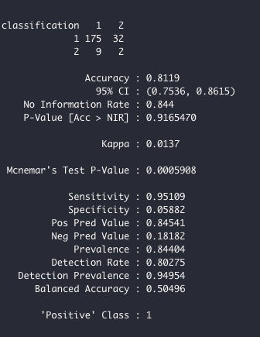
Attrition Prediction Model
Ran my KNN with K=3
Sensitivity = 0.95
Specification = 0.05
Accuracy = 0.811
The model is not doing well at not predicting when Attrition is no

Slide 15
Attrition Prediction Model
I later iterated through different K’s to get the best Accuracy
When K = 20 we have the highest accuracy

Slide 16
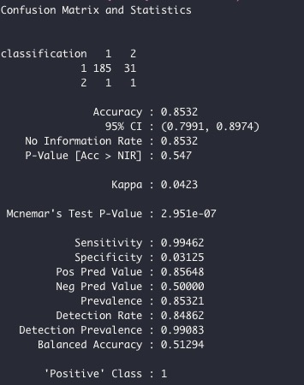
Attrition Prediction Model
When K = 20 our metrics improve a little bit

Slide 17
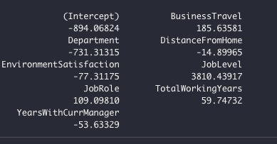
Monthly Income Prediction Model
I used Multilinear regression as my model
To select my features I used the stepwise model
The image shows the best features for my model

Slide 18
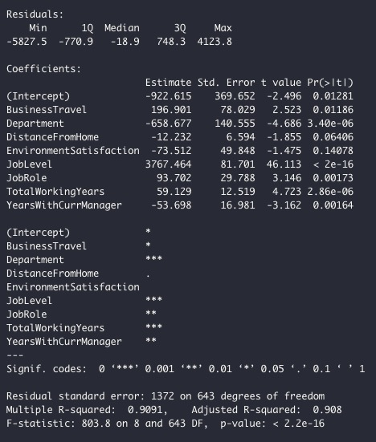
Monthly Income Prediction Model
I ran the regression with the selected features
Here are results
My R-squared is 0.91 which is good
The RMSE = 1362

Slide 19
Monthly Income Prediction Model
Before we use this model here are my assumptions
As you can see we meet the assumptions:
Linearity
Normal distribution
Equal standard deviation
Independency

Slide 20
My factors vs Model Selection features
Top 12 KNN Model Features | My top Features
Over Time | Monthly Income
Monthly Income | Age
Total working Years | Jobs Satisfaction
Years At Company
Stock Option Level
Maritial Status
Job Level
Years in current role
Years with curr manager
age
Job involvement
Job Satisfaction
Job role
Based on my Hypothesis my top features did play a part in predicting Attrition. However, I was surprised that only monthly income from my list was in the top 3.

Slide 21
Attrition prediction for my work environment
Below are my data points to feed to the model
Age = 34,
Department=3,
DistanceFromHome=40,
JobInvolvement=3,
JobLevel=3,
JobRole=7,
JobSatisfaction=3,
MaritalStatus=2,
MonthlyIncome=***,
OverTime=1,
StockOptionLevel=0,
TotalWorkingYears=7,
YearsAtCompany=3,
YearsInCurrentRole=0,
YearsWithCurrManager=0
And the result was – No Attrition, which is right. I love my job.

Slide 22
Conclusion
Overall, the project was fun because I related it to my current Job
My Hypothesis was correct
And we managed to get high accuracy metrics for the two models
However the top 3 leading factors according to KNN the cause Attrition are:
Overtime
Month Income
Total Working Years

